Slide 1

State of Illinois Revenue Data – Time Series Forecasting
Megan Cusey
MSD 570 Fall A 2019

Slide 2
Objectives
Explore Data
Review results of the model
Next Steps

Slide 3
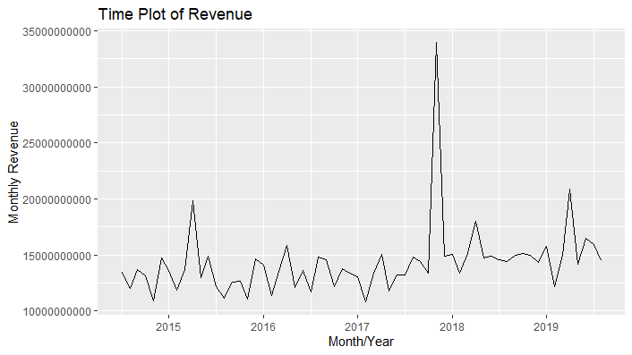
Data Exploration
Interesting observations of the revenue data include:
Slight upward trend between 2017 – 2019
The consistent upwards and downward spikes across the years indicate there is a seasonality component between the data.
There is a spike around November of 2017 that appears unusually large.
Figure 1 – Plots the monthly revenue data as a function of time.

Slide 4
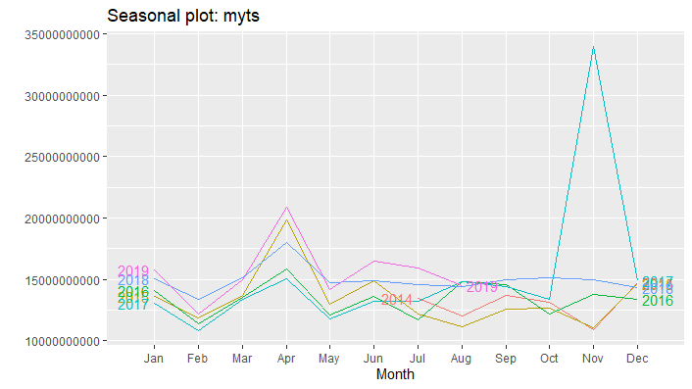
Data Exploration – Continued
The seasonal plot of the data offers
the following additional information:
There appears to consistently be a dip in revenue in February
There is a consistent spike of revenue in April
Figure 2 plots the revenue data for each year as a function of the month

Slide 5
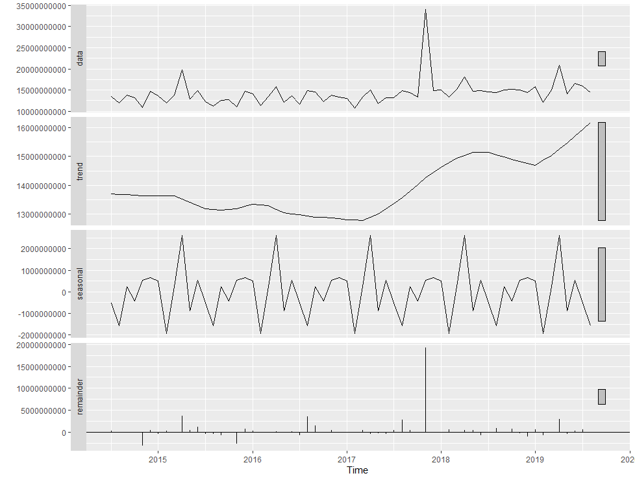
Data Exploration - Continued
Interesting observations of the revenue data include:
Confirms upward trend between 2017 – 2019
Confirms seasonality component in the data
The gray scale on the right represents the scale of data compared to the original data. The trend and seasonality isn’t as much as a key factor as the remainder compared to the original dataset (partially due to outlier)
Figure 3 – Time Series Decomposition using STL

Slide 6
Model Evaluations
RMSE – Root Mean Squared Error; The standard deviation of residuals. RMSE is a metric that measures how far the fitted values are from the observed values.
MAPE – Mean Absolute Percentage Error; Unit free measurement that represents the percentage of errors.
AIC – Akaike’s Information Criterion; Assesses each model by considering the fit of the model to observed values while also penalizing model for number of parameters needed to be estimate (i.e. model complexity).

Slide 7
Simple Methods - Continued
Model Name | Description | RMSE | MAPE | TREND | SEASONALITY
Drift Method | Averages the change in the historical data to calculate a slope and uses the resulting line to forecast future values. | 2114826753 | 8.127975 | Yes | No
Naïve Method | Forecasts all future values to the last observation. | 2178374718 | 4.924187 | No | No
Average Method | Forecasts all future values to the average of the historical data | 2465492089 | 10.80514 | No | No
Seasonal Naïve | Forecasts all future values to the last observation of the same season. | 2848729922 | 10.822929 | No | Yes
A variety of simple methods are used in order to create a benchmark to compare against more complex models.
Table 1 – Results of Simple Method Models

Slide 8
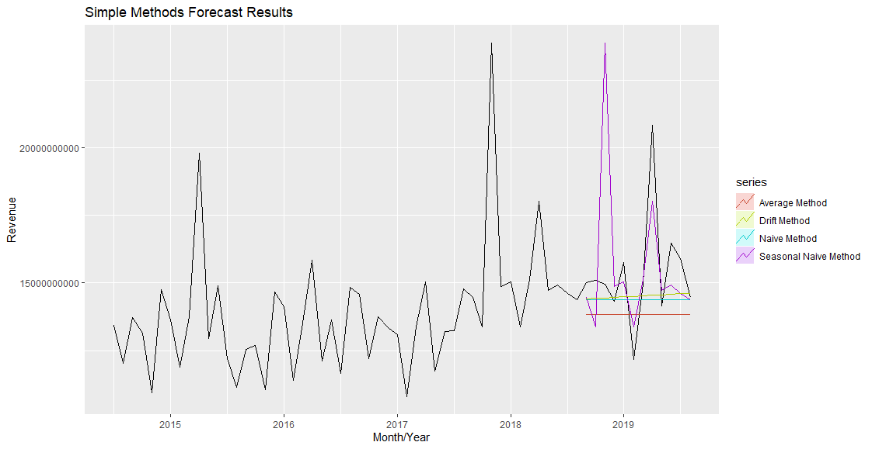
Simple Methods - Forecasts
Figure 4 – Simple Methods Forecast Results

Slide 9
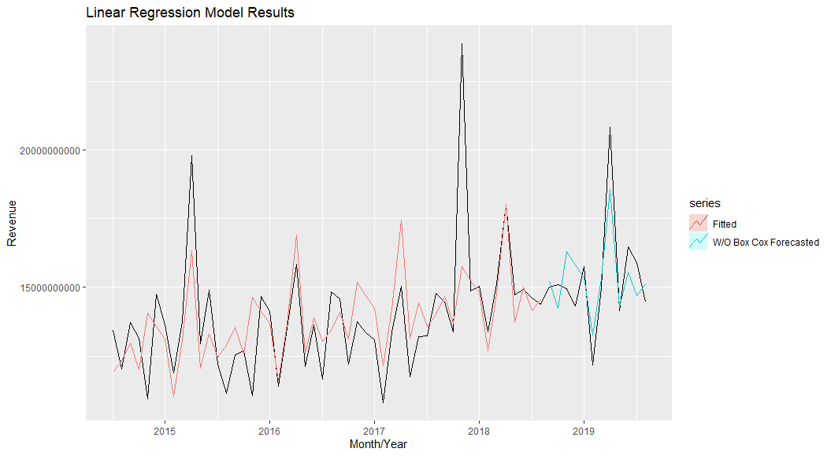
Linear Regression
Model Name | Description | RMSE | MAPE | TREND | SEASONALITY
Linear Regression | Uses the linear relationship between the forecast variable (y) and the predictor variable (x) to obtain the forecast value. | 1084874242 | 5.814253 | Yes | Yes
Table 2 – Results of Linear Regression
Linear Regression Model minimized RMSE more than our Simple Methods – Drift Model benchmark!
Figure 5 – Time Series Decomposition using STL

Slide 10
Exponential Smoothing
Model Name | Description | RMSE | MAPE | TREND | SEASONALITY
Holt-Winters' Seasonal Method Multiplicative | Extends Simple Exponential Smoothing by applying both a trend and seasonal component. Multiplicative - The variation of the seasonal component is proportional to the level of the series. | 1163163677 | 5.916772 | Yes | Yes
Holt-Winters' Seasonal Method Multiplicative - Damped | Extends Simple Exponential Smoothing by applying both a trend and seasonal component. Multiplicative - The variation of the seasonal component is proportional to the level of the series. Damped - Parameter that seeks to reduce over forecasting values. | 1272878987 | 6.771351 | Yes | Yes
Holt-Winters' Seasonal Method Additive | Extends Simple Exponential Smoothing by applying both a trend and seasonal component. Additive - Describes the seasonal component. Additive is most appropriate when the seasonal variances is typically consistent throughout the time series. | 1295679000 | 6.847373 | Yes | Yes
Table 3 – Results of Exponential Smoothing Method Models
The main concept being Exponential Smoothing is to optimize weighted averages for different components (seasonal, trend, remainder/error) of the data set.
Additive and Multiplicative characteristics are assigned to these components in ETS (state space model) to describe the stability of the data.
Table 3 – Results of Exponential Smoothing Method Models

Slide 11
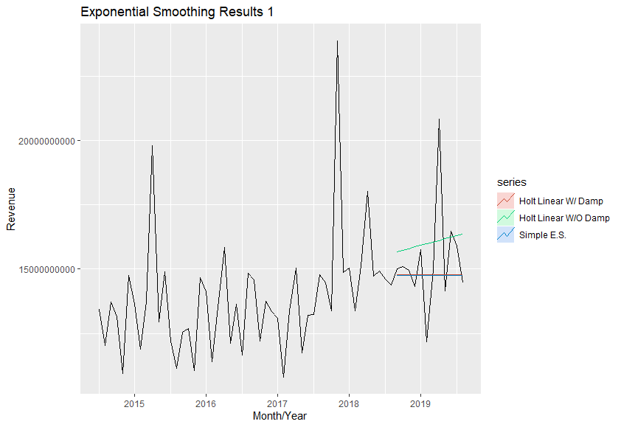
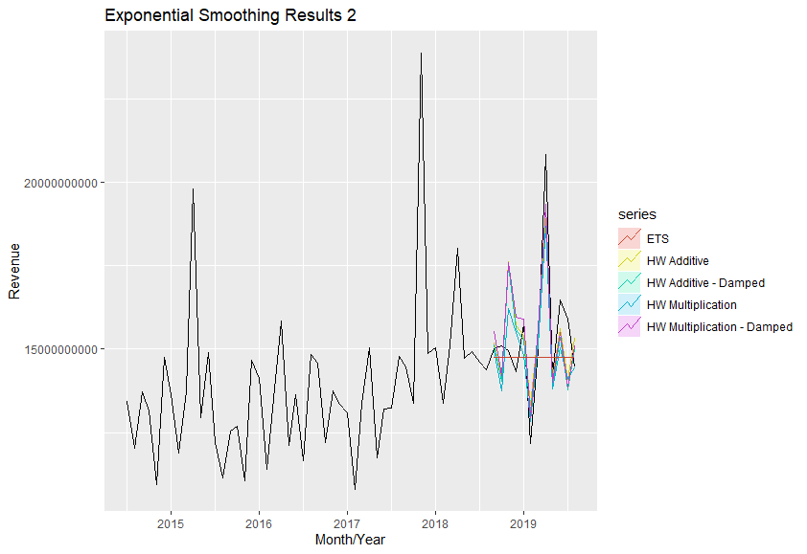
Exponential smoothing method model forecasting results
Figure 6 – Exponential Smoothing Meth Model Forecasting Results

Slide 12
ARIMA Method Models
Table 3 – Results of Exponential Smoothing Method Models
Model Name | Description | RMSE | MAPE | TREND | SEASONALITY
Moving Average | The moving average model uses its previous forecast errors to produce a regression like model for future forecast values. | 2193409890 | 9.360846 | Yes | Yes
Autoregressive | The autoregressive model uses previous values of the dependent variable (the variable we want to forecast) and creates a linear line of regression to produce forecast values. | 2592679768 | 13.2813 | Yes | Yes
ARIMA | ARIMA stands for AutoRegressive Integrated Moving Average model. It applies both concepts of the MA and AR models with stationary data. | 2999944065 | 15.02368 | Yes | Yes
For Autoregressive and Moving Average Models, data must be stationary.
ARIMA combines AR and MA methods.
ARIMA stands for AutoRegressive Integrated Moving Average
AutoRegressive models use the previous observations of the target attribute to produce a linear regression that forecasts values.
Moving Average models use the previous forecast errors of the target attribute to produce a regression that forecasts values.
Table 4 – Results of ARIMA Method Models

Slide 13
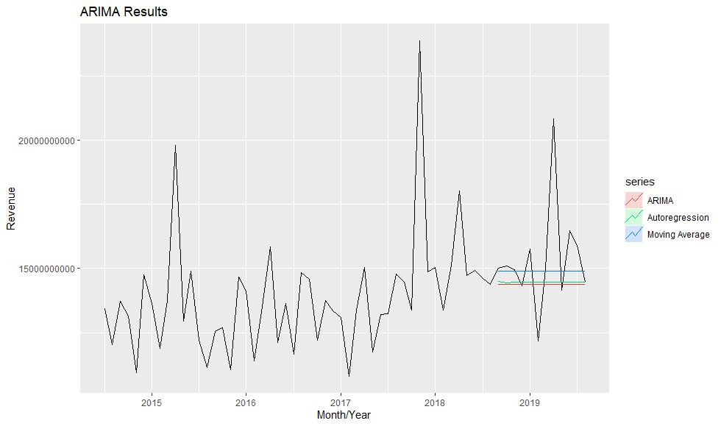
ARIMA Method Models
Figure 8 – ARIMA Forecast Results

Slide 14
Linear Regression Model
Linear regressive model produced the best forecasts by reducing RMSE and MAPE.
The next step in the forecast model process is to check residuals.
The following properties will be investigated:
The residuals of the model are not correlated. If correlation is observed in a model, it means that there is information in the left-over data that isn’t being utilized in the model. Uncorrelated residuals indicate that the remaining information is white noise.
The residuals have a mean of zero. Residuals that do not have a mean of zero is an indicator that the forecasts are biased.
The residuals have a constant variance.
The residuals are normally distributed.

Slide 15
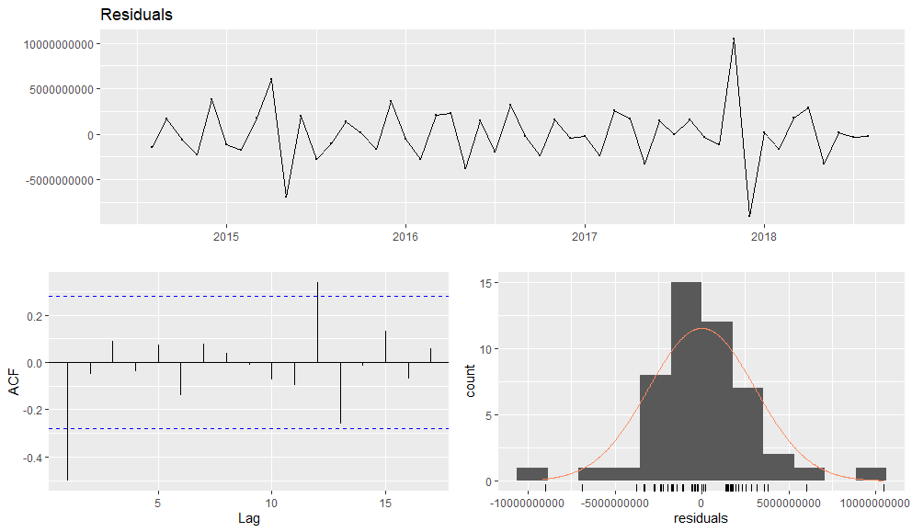
Linear Forecast residuals
The means of the residuals are around zero which indicates no forecast bias.
There is some autocorrelation, but not too much. There may be some predictor variables to investigate to see if the model can be improved.
There is variance in the residual plot and the distribution isn’t quite normal which will make it more difficult to calculate prediction intervals.
Figure 9 – Linear Forecast Residuals

Slide 16
Next Steps…
Try modeling approaches where data are aggregated by daily average instead of monthly.
Identify why the November 2017 outlier exists.
Understand why there appears to be a consistent decrease in revenue in February and increase in revenue in April.
Explore other potential predictor variables such as legislative changes, Comptroller leadership changes, tax season, etc.

